Slide 1
Knowladge Base
05 JUL, 2022

Slide 2
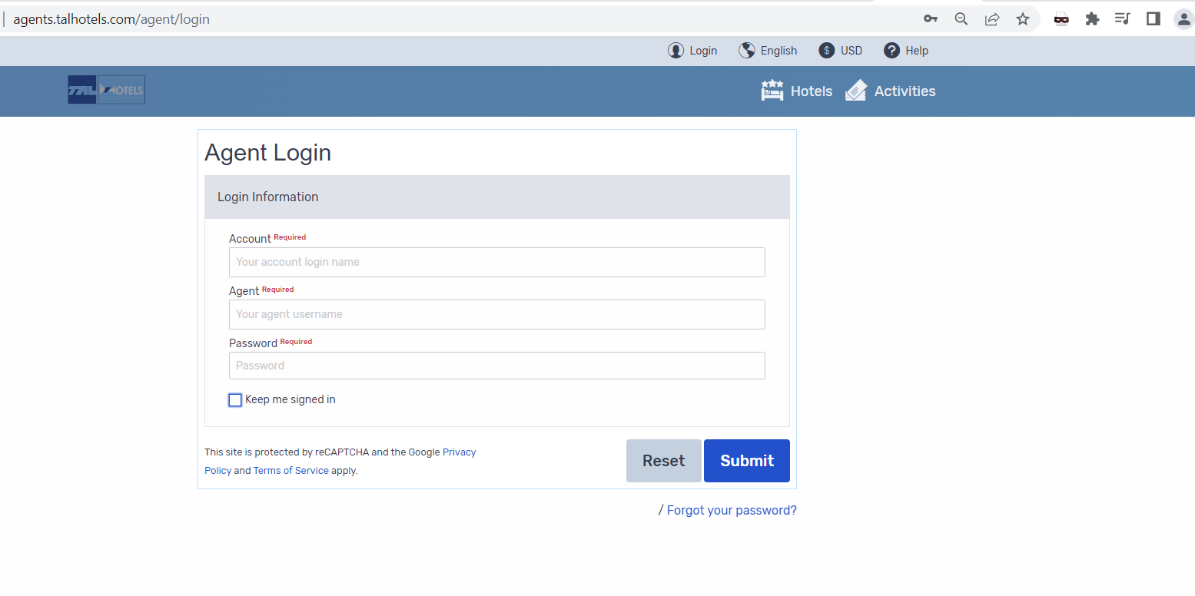
Start working
Pls use only EUR
Go to link www.talhotels.com
Go to link www.talhotels.com
Please enter given credentials to enter system
Please read the system rules

Slide 3
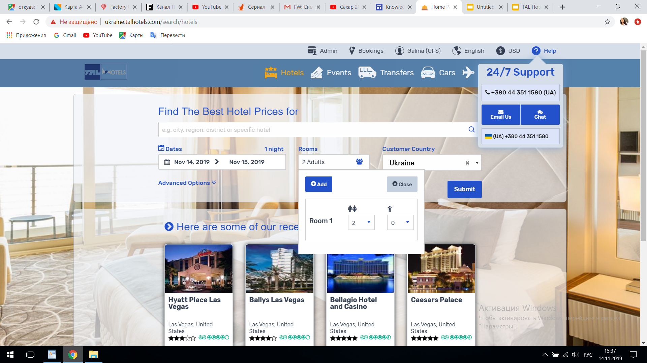
Admin actions
Your bookings
Contact us in case you need help
Hotels search parameters
Book the hotel
Tick the box if you want to see on request hotels
Max bookings can be done 6 rooms,
6 pax per room
Pay at the hotel –those bookings belongs to Booking.com, client should pay directly at the hotel. Tick the box if you want to exclude it.

Slide 4
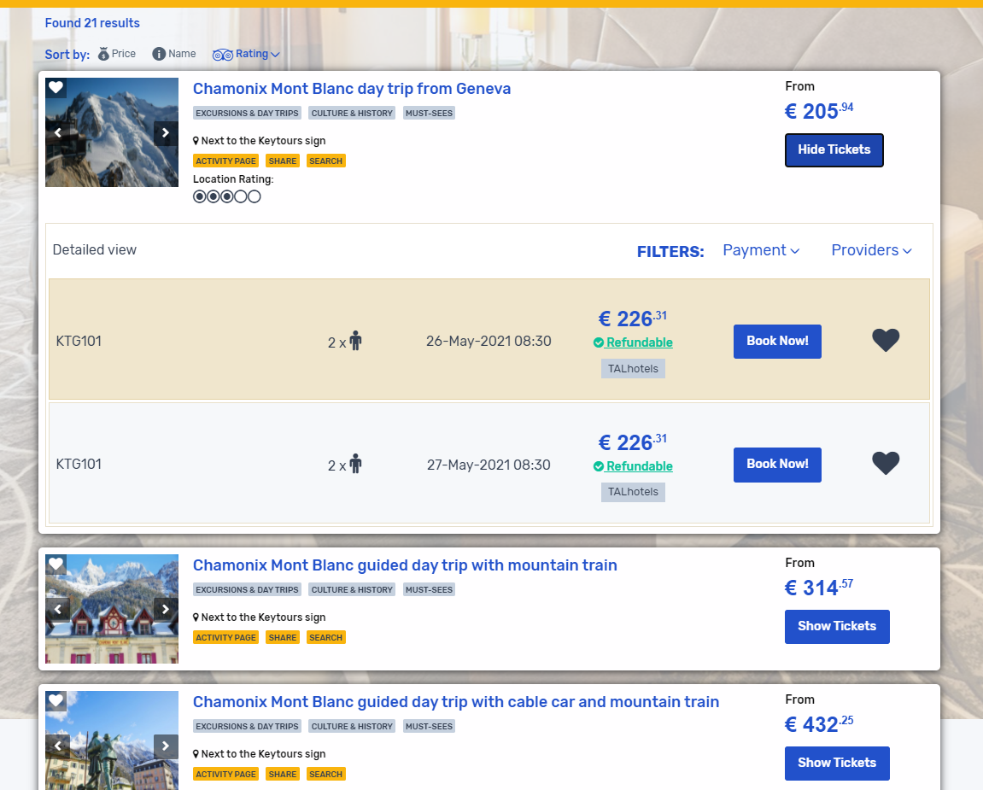
Book activities in TAL Hotels

Slide 5
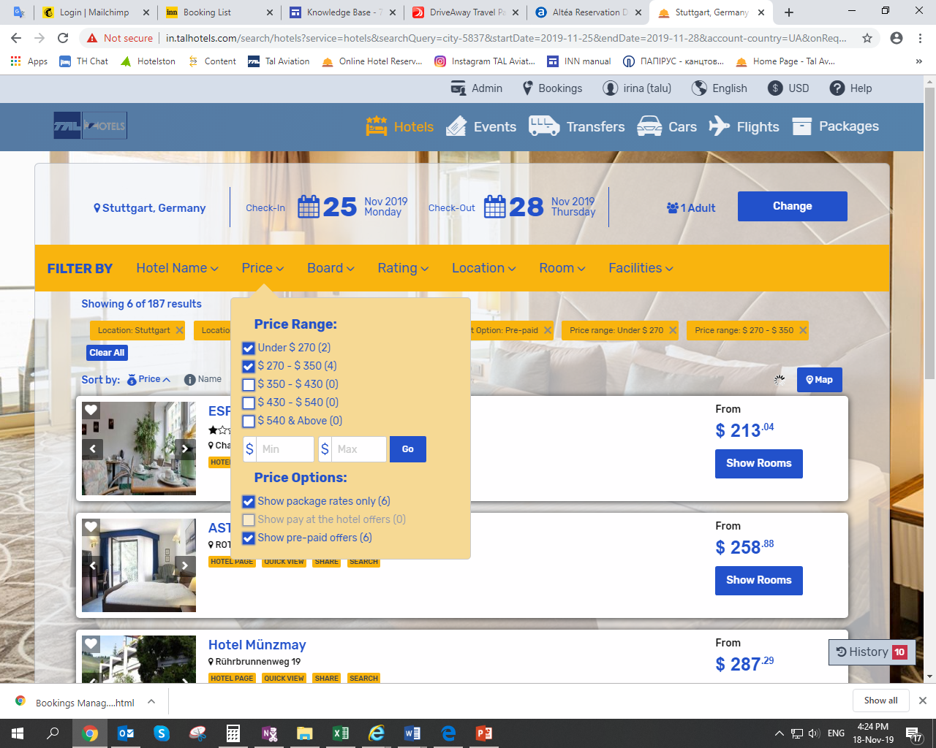
Filter your searching results
Available filter :
Hotel name
address
City and many others
Always refresh your searching result

Slide 6
Filter your searching results Category view & Detailed view- helps you to get more details about the available rooms .

Slide 7
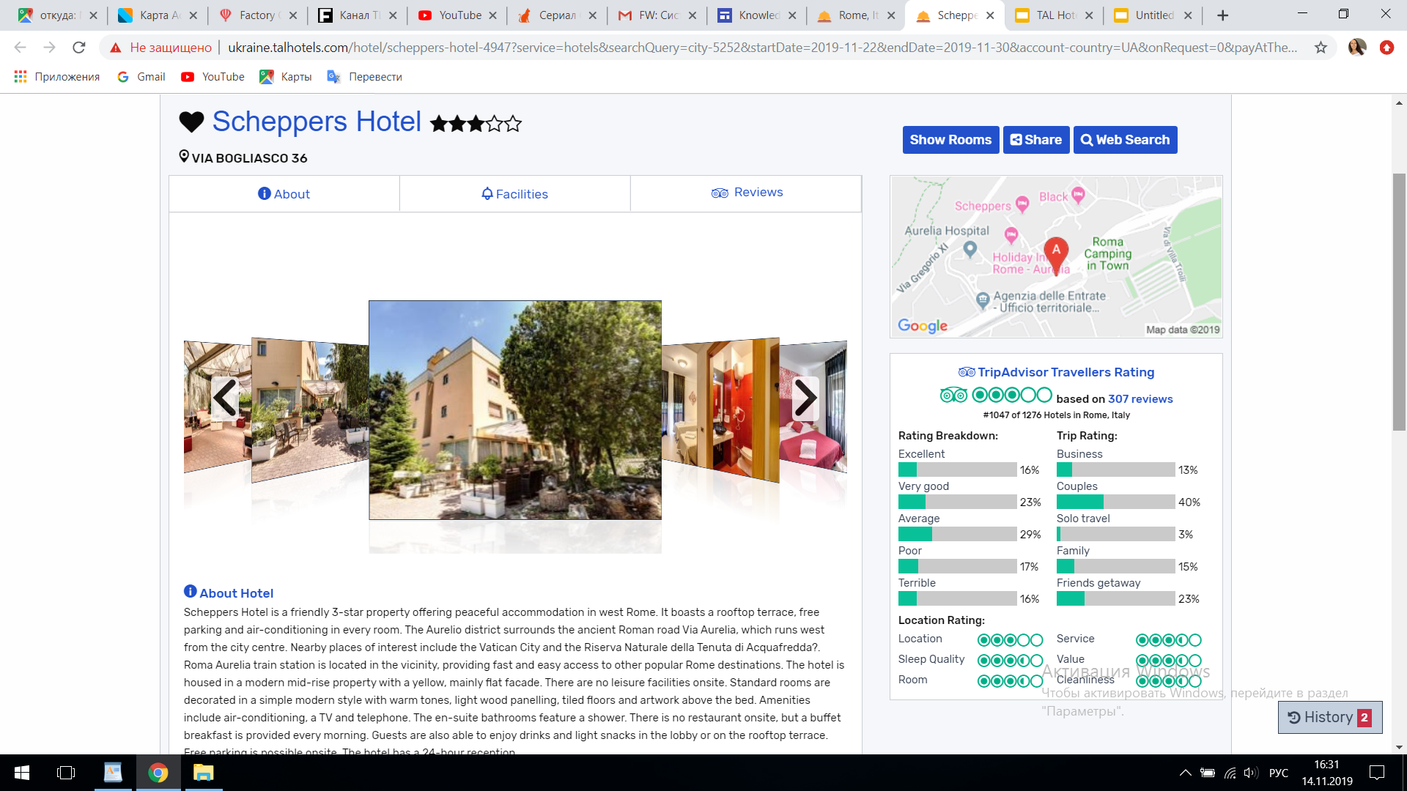
More Information about the hotel
Check hotel facilities
TripAdvisor

Slide 8
Offer to the client
TAL Hotels offer possibility to send offer to your client with manually amended fares
Press the symbol and hotel will be moved to comparison table

Slide 9
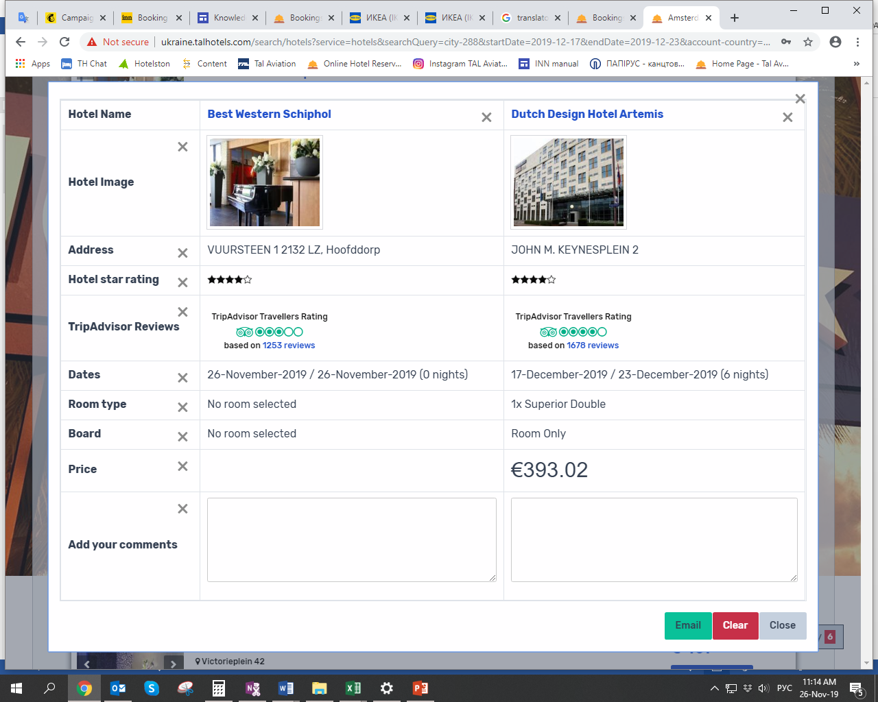
Offer to the client
Press box and amend your offer in table.
1. To delete fare press the «Х» box and insert your fare in Price box
2. Email box- if you want to send offer by mail.
3. If you need you can “ Add your comments” box
4. Delete hotel from the list

Slide 10
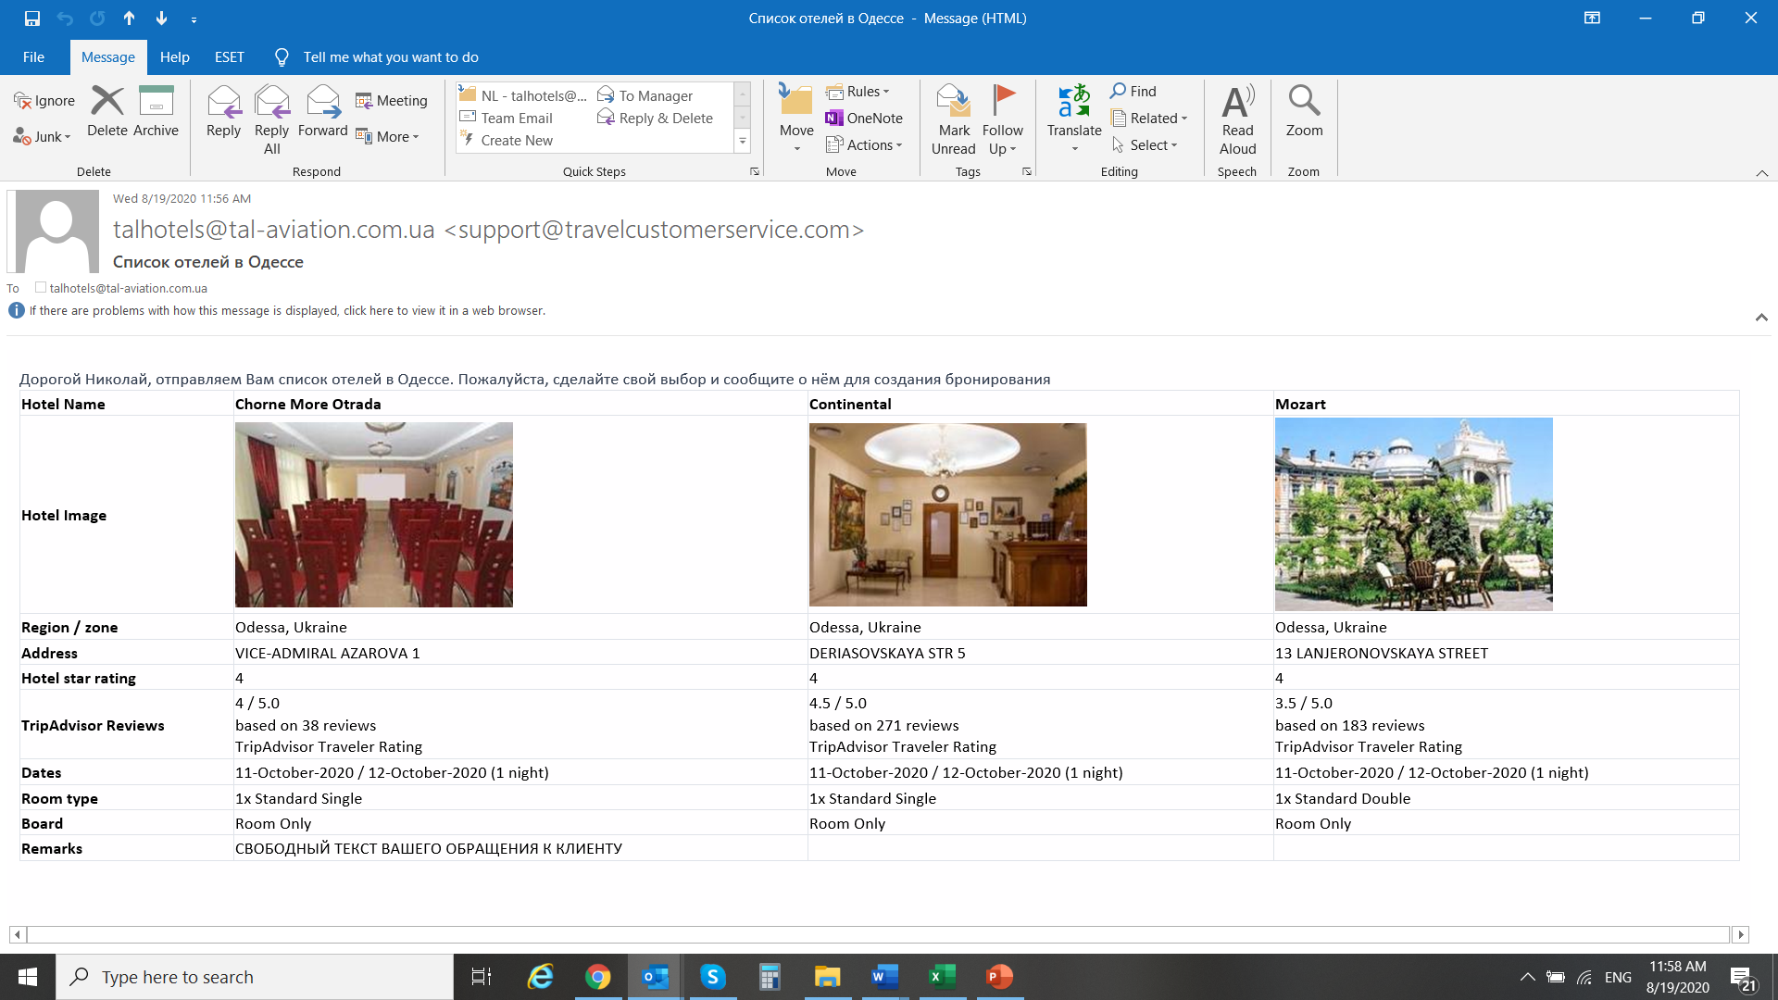
Offer to the client

Slide 11
Hotels booking
1. Check if this is hotel you are loking for
2. Insert names
3. Special request – add if you need hotel to be informed about some special request.

Slide 12
Hotels booking
Read Terms and Conditions and press the “ book now “ box.

Slide 13
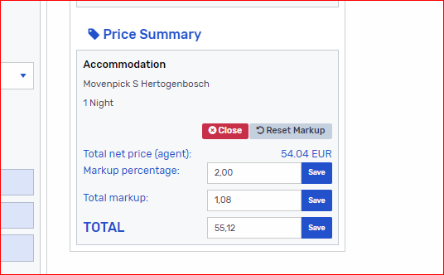
Hotels booking – Markup set up
While booking creation, after entering the passenger name, it is possible to change markup using the calculator. You have to press "save“ and the new fare for your client/ subagent will appear in the booking .

Slide 14
Confirmation page
1. Booking number
2. Booking status

Slide 15
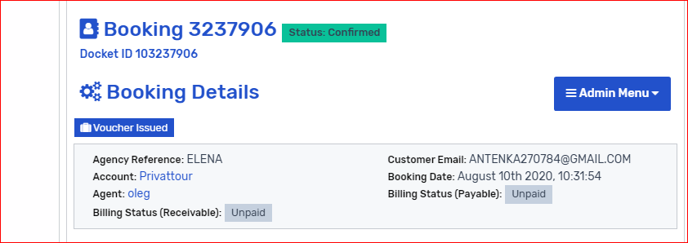
Issue voucher The fact of selling the service in the TAL Hotels booking system is the issuance of a voucher. Therefore, we remind you that until this moment the sale is pending and booking might be auto canceled by system.
Confirmation that «Voucher issued “.

Slide 16
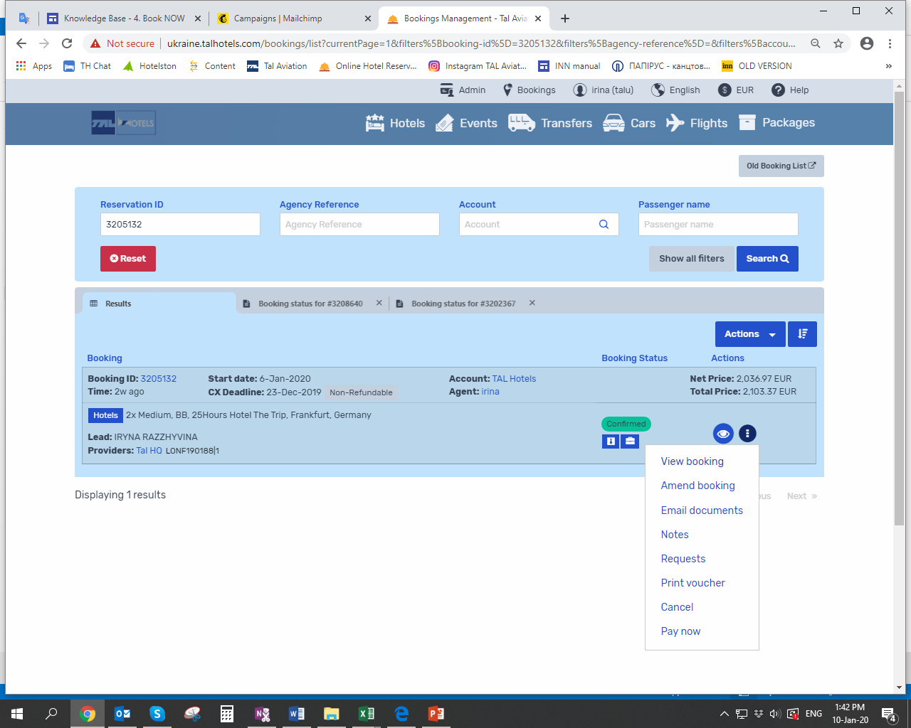
Booking Management
-press the dots and manage your booking

Slide 17
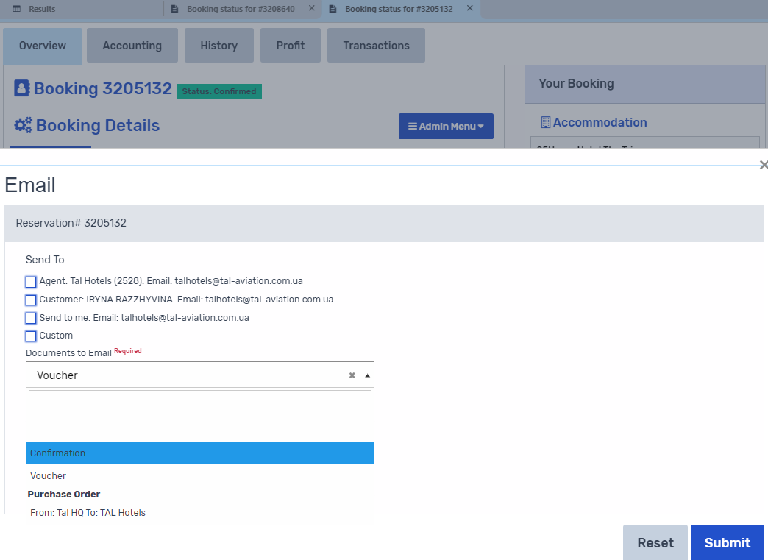
Booking Management Duplicate your voucher by e-mail in case you have lost it, there is an opportunity to re-receive the voucher by mail.

Slide 18
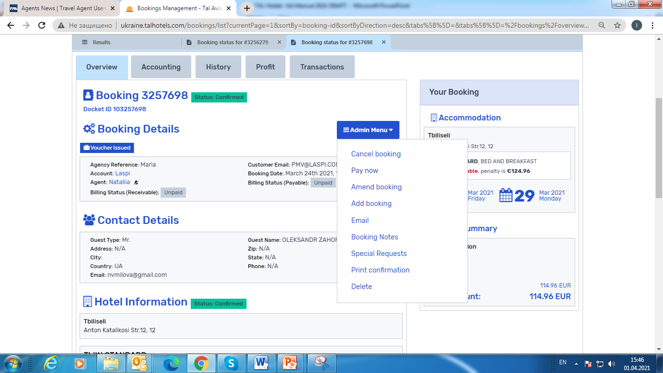
Booking Management you can Cancel refundable booking

Slide 19
Booking Management Force cancellation massage
Important !
if the system sends warning massage “Force cancellation” while canceling a reservation, do not proceed with the cancellation.
Contact the TAL office immediately to request a cancellation. This option alerts you to specific cancellation policies and requires confirmation that the booking has already been canceled by the provider in their system. This request is sent by TAL agent support !
If you cancel such a booking, additional penalties from the supplier may apply.

Slide 20
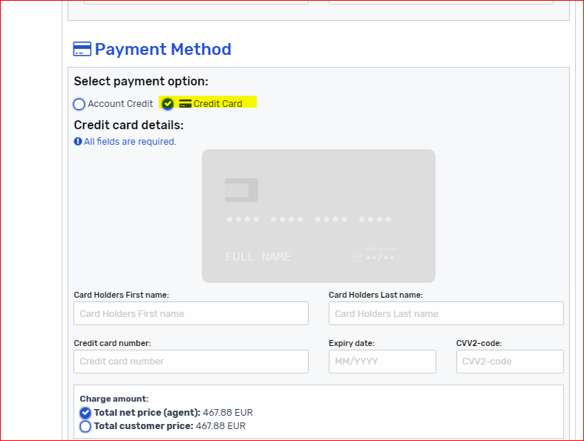
Payment options
System offers two payment options “account credit ” and “credit card”(СС).
Bank charges and possible commissions for CC payments applied

Slide 21
Payment by CC in existing booking
After booking created and get “confirmed” status, you can proceed with the payments.
Please open page “pay now” if you want to pay by CC and follow the instruction.
IMPORTANT:
click “PAY NOW” ONLY ONCE. Otherwise each your click will add the bank charges

Slide 22
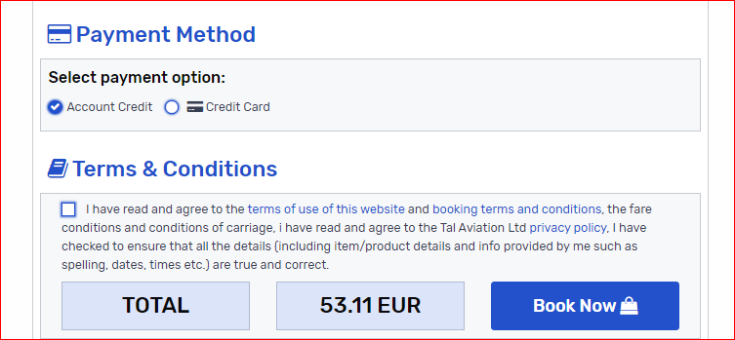
Payment options by Account Credit
If you want to pay using “ account credit “press the bottom “ account credit “ finish booking process. After boking will have confirmed status, send request by mail for invoice to handling office.

Slide 23
Bookings with form of payment “Pay at the hotel”
If you create the booking with “pay at the hotel option “ – those bookings belongs to Booking.com as a provider.
You can not use any other payment options to collect your mark up,
because client should pay directly at the hotel.

Slide 24
Manuals & handbooks TAL Hotels are here

Slide 25
Thank you !
Handling office
TAL Aviation LLC ( Ukraine, Kiev )
Agents support :
E-mail: talhotels@tal-aviation.com.ua
Skype: tal_office

